Slide 1
Resit assignment 1

Slide 2
AGENDA
Initial status
Making of tests (part 1)
Making of tests (part 2)
Final product
Further information

Slide 3
Initial status
PROJECT CHOSEN
COUNTING LINES
CODE MESUREMENT
Back to agenda

Slide 4
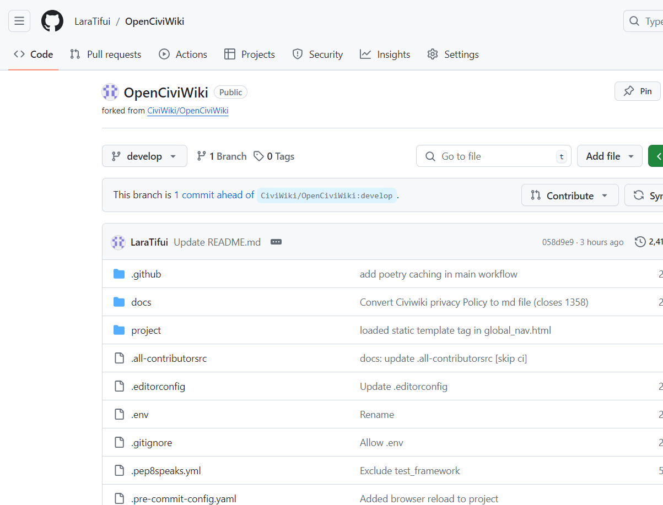
PROJECT CHOSEN
NAME : CIVIWIKI
Name of the fork: OpenCiviWiki
Language: Python
License: GNU Affero General Public License.
Back to menu

Slide 5
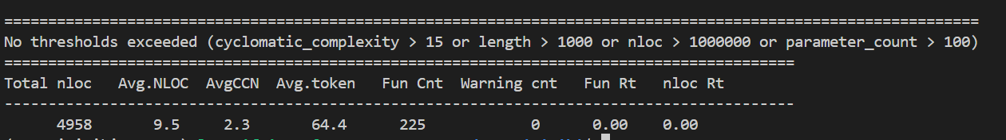
Counting Lines
TOOL used: Lizard
Back to menu
Argument used in terminal:
lizard -l python

Slide 6
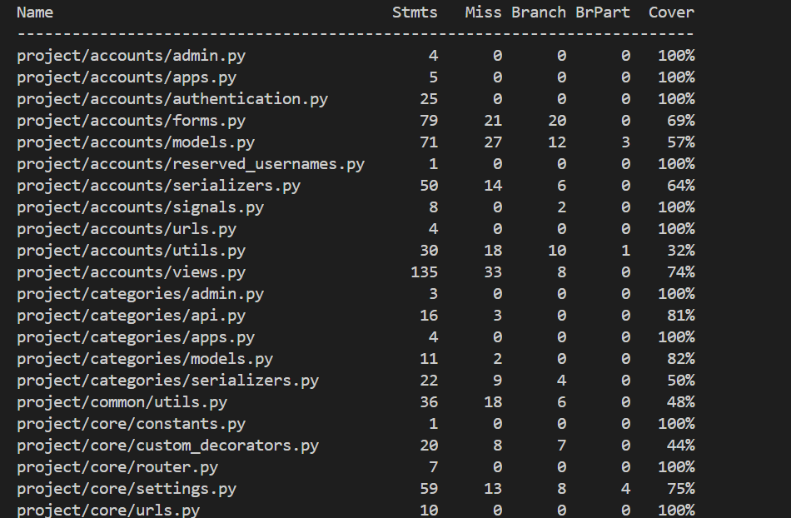
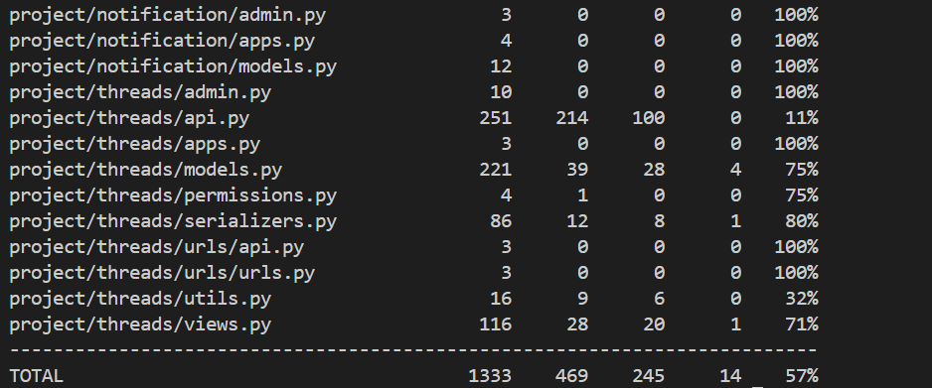
Coverage tool:
Name: Coverage.py
Language: Python
Initial overall coverage: 60%
However, the branch overall coverage is 57%
In Terminal:
coverage run --branch -m pytest
coverage report
coverage html
Back to menu

Slide 7
Making of Tests (part 1)
Initial state of the function
Tests added
Improvements
Back to agenda

Slide 8
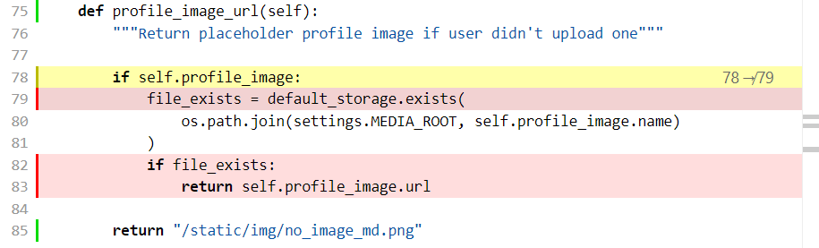
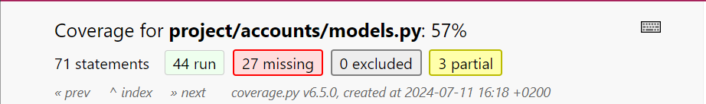
Initial state:
The function chosen is found in project/accounts/models.py, called: profile_image_url()
The coverage tool showed that the file was only 57% covered:
Back to menu

Slide 9
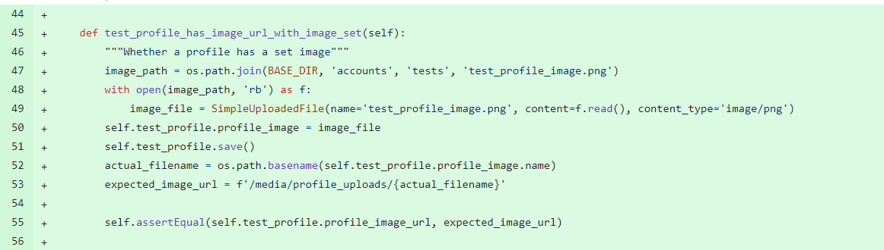
Tests Added
->Extras
The function profile_image_url, had 50% branch test coverage, since a unit test already existed in the case a profile had no image associated with it, so the default image is used. After adding 1 unit tests , in order to check if the profile is correctly set when an image is associated with the profile, the function has now 100% branch coverage and the total coverage of the models.py file has raised from 57% to 86%
Back to menu

Slide 10
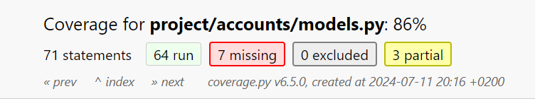
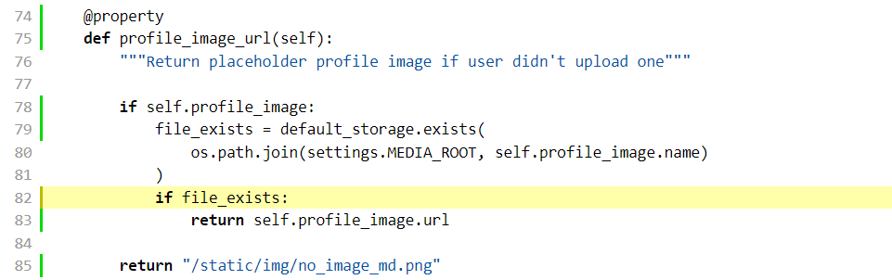
Improvements:
Back to menu

Slide 11
Making of tests (part 2)
Initial state of the function
Tests added
Improvements
Back to agenda

Slide 12
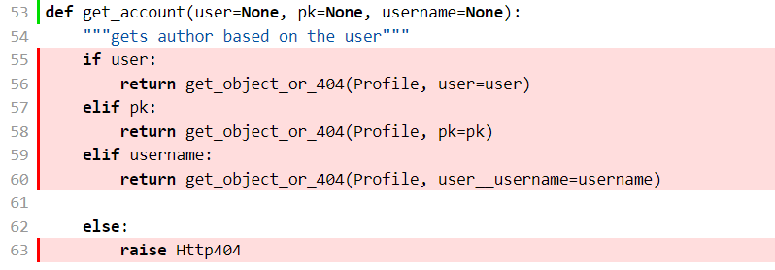
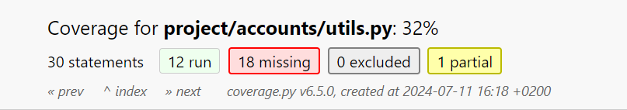
Initial state of function:
In projects/accounts/utils.py, the function chosen is: get_account()
The initial coverage of the file the function is in:
Back to menu

Slide 13
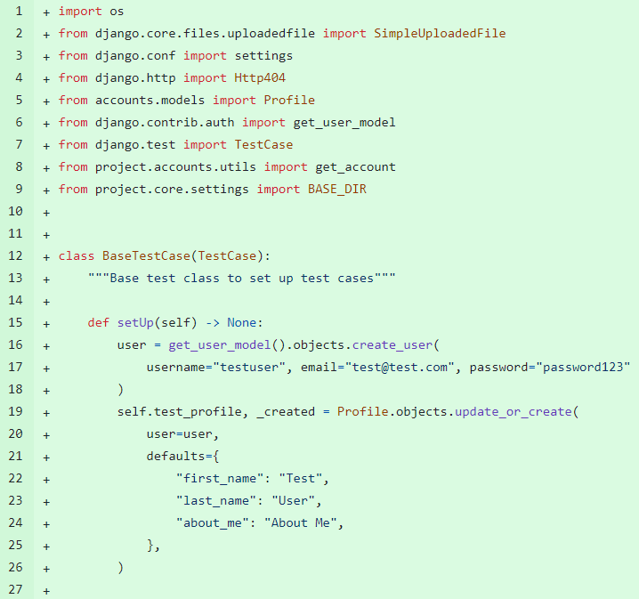
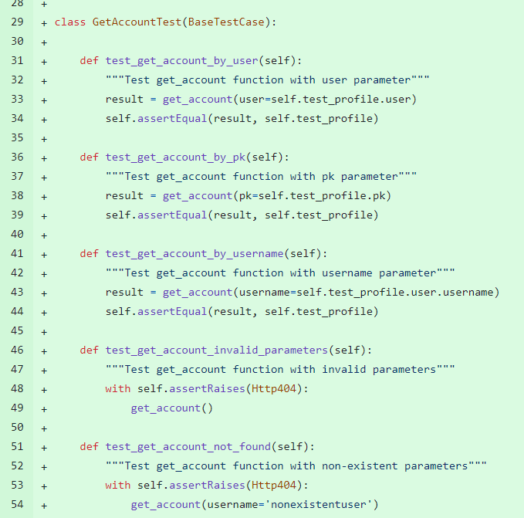
Tests Added
Back to menu
Notes:
The function get_account, which has 3 optional parameters, had 0% test coverage. After adding 5 unit tests , in order to check each of the possible calling situations covered by the function coding, the function has now 100% branch coverage and the total coverage of the utils.py file has raised from 32% to 65%

Slide 14
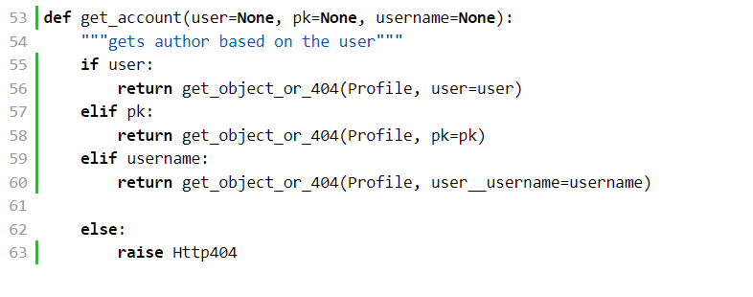
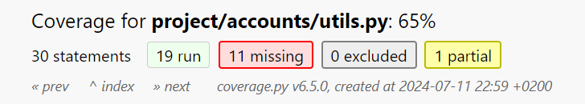
Improvements
The function get_account, which has 3 optional parameters, had 0% test coverage. After adding 5 unit tests , in order to check each of the possible calling situations covered by the function coding, the function has now 100% branch coverage and the total coverage of the utils.py file has raised from 32% to 65%
Back to menu

Slide 15
Final product
Final state
Back to agenda

Slide 16
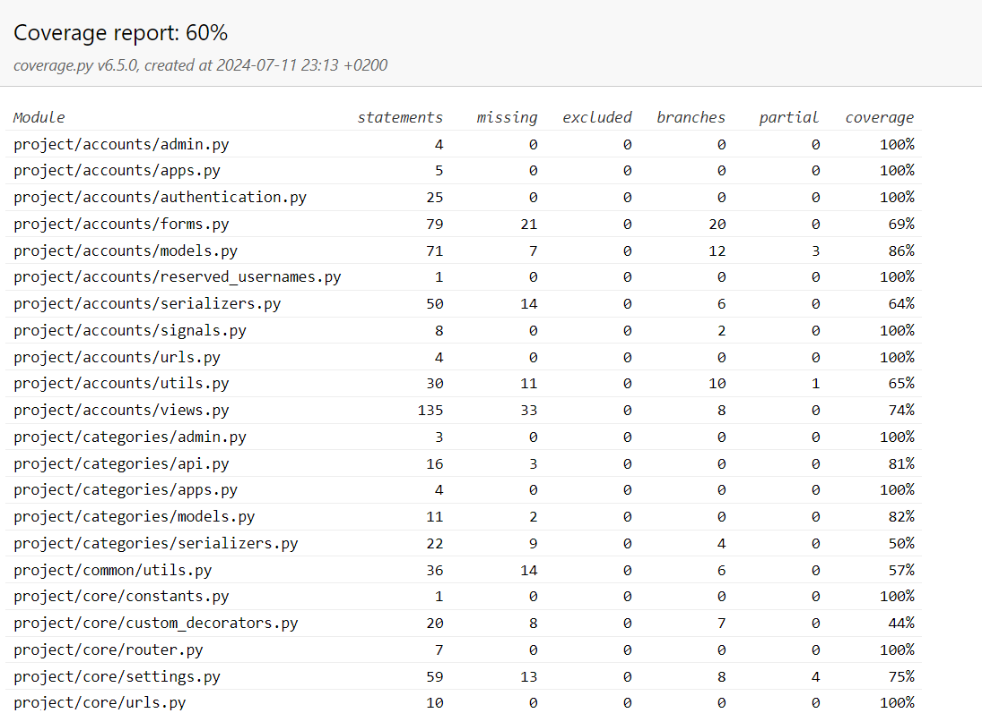
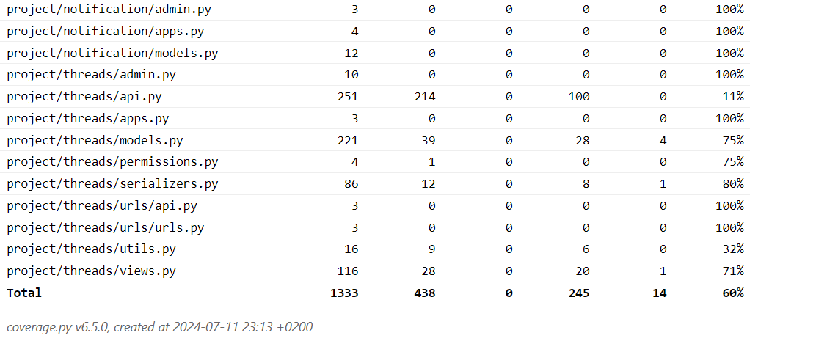
Final State
Back to menu
Final overall branch coverage: 60% (starting with 57%)

Slide 17
THANK YOU
Any further questions?

Slide 18

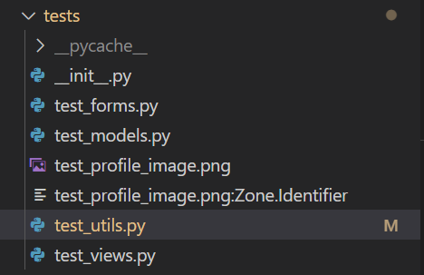
Extras:
For the 1st function there was a need if a tester image of the profile in order to check in general for profile images that are set.
The following png was used and placed in the folder for test in order for the newly created test to access it, under the name test_profile_image.png:
Back to slide

Slide 19
THANK YOU
Thank you for your time!

